Slide 1
Convolutional neural network based deep learning architecture for prostate cancer detection on multiparametric magnetic resonance images
Sara Khosravi
September 2021

Slide 2




Convolutional Neural Network Based Deep-learning Architecture for Prostate Cancer Detection on Multiparametric Magnetic Resonance Images
Published in 2017 in SPIE
Cited 55 times
Code not available!
Yohannes K. Tsehay
Lal Hussain
Holger R. Roth
Xiaosong Wang

Slide 3
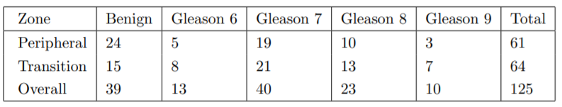
Dataset
Not publicly available!
Fig. 16: Lesions stratified by location and severity

Slide 4
Methods

Slide 5
Architecture
Five separate CNNs
Each of the five convolutional layers have their own loss function and learn in a deeply-supervised fashion
Ground-truth is used in every layer for supervision to force each one to learn discriminating features.
The five side outputs can be combined for a fused output.

Slide 6
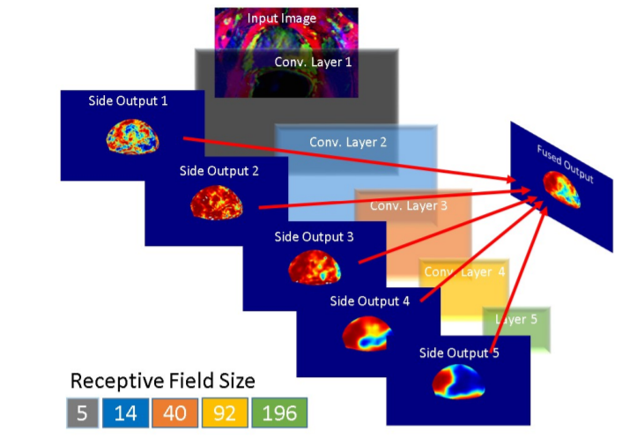
6
Fig.17 : 5 separate CNNs

Slide 7
Evaluation

Slide 8
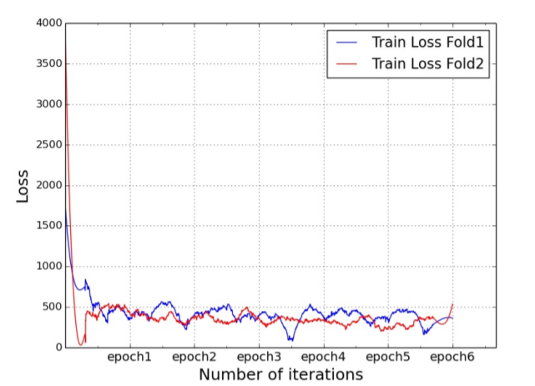
Results
Used k-fold cross validation
Cross Entropy Loss used
Fig. 18: Loss

Slide 9
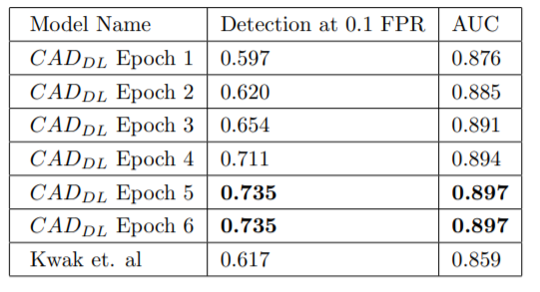
Results
AUC: 0.89
Fig. 19: AUC

Slide 10
Summary
Detecting prostate cancer using deep learning convolution neural network with transfer learning approach
Overfitted, low transferability, dataset specialized
A Transfer Learning Approach for Malignant Prostate Lesion Detection on Multiparametric MRI
Source cod not available, but results seems to be realistic
Convolutional Neural Network Based Deep-learning Architecture for Prostate Cancer Detection on Multiparametric Magnetic Resonance Images
Source code and dataset not available, need to be more detailed, seems to be realistic

Slide 11
Thanks For Your Attention
Any Questions?
Contact: srkhsrv21@gmail.com

